Slide 1
Installation of TDC on windows
#Install and setup a java path
https://www.oracle.com/java/technologies/downloads/#java11-windows
#sign in in the oracle account and download
(or)
https://bell-sw.com/pages/downloads/
#install the java and setup the path of java
#Goto windows PowerShell & check the java is set.

Slide 2
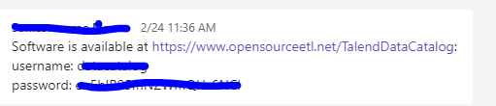
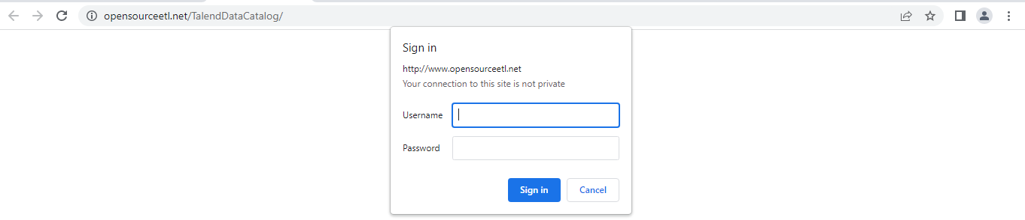
Installation of TDC on windows
#Install TDC .Zip file for windows
#click on this link
https://www.opensourceetl.net/TalendDataCatalog
#give the username and password

Slide 3
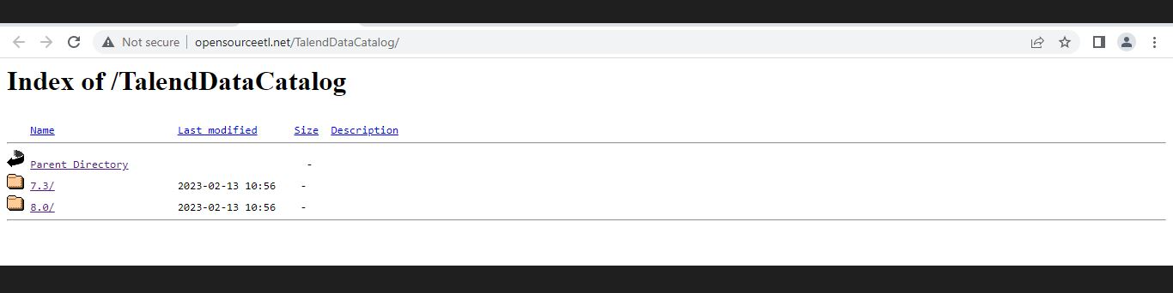
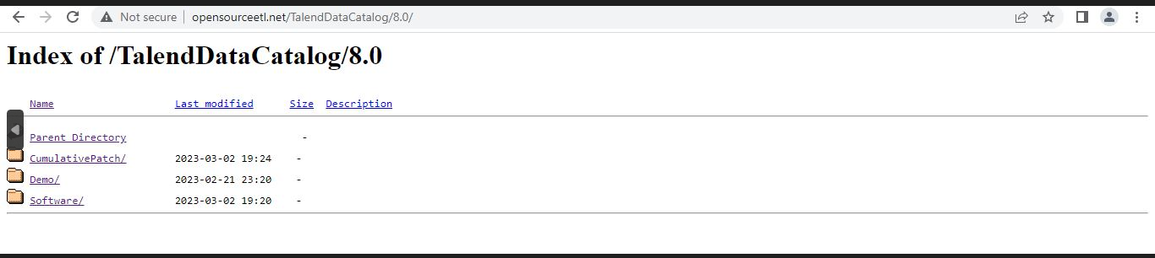
i)8.0
ii)Software
iii)Download TDC-8-20230302.zip file

Slide 4
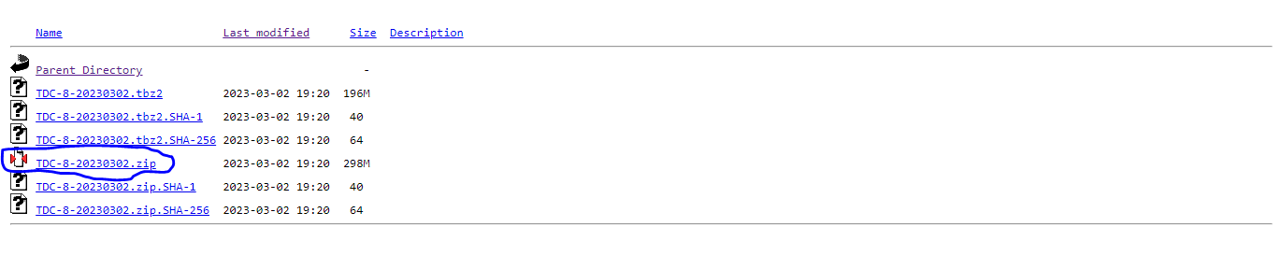
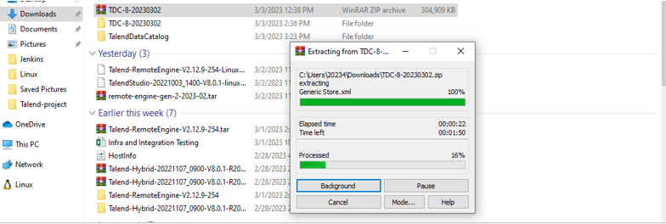
#Right click on TDC-8-20230302.zip file
#Extract the TDC-8-20230302.zip file

Slide 5
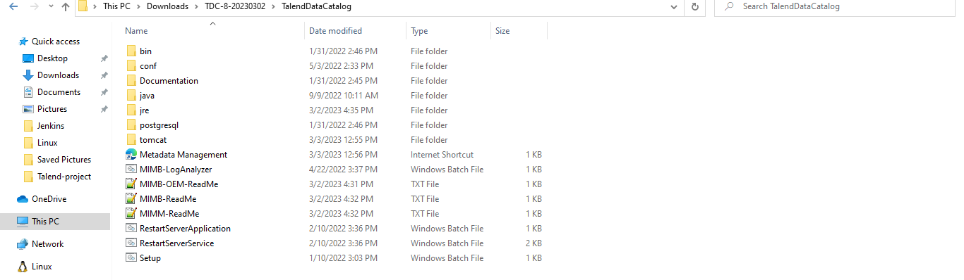
#Go inside the TDC-8-20230302 folder

Slide 6
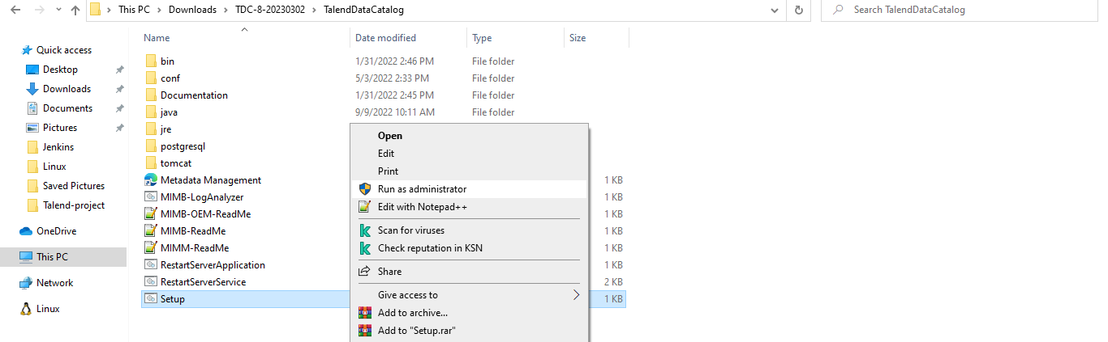
#Right click on setup.sh
i)Run as administrator
#setup will be finish

Slide 7
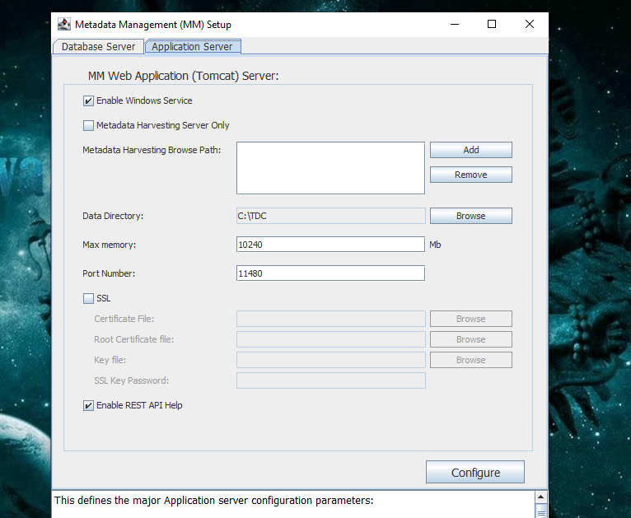
#Goto Application server
#make a installation directory in C: drive
#create new folder TDC
i)Browse the folder in data directory
#Enable windows service
#Enable rest Api
#max memory 10240
#port 11480
#At last configure
Action successful

Slide 8
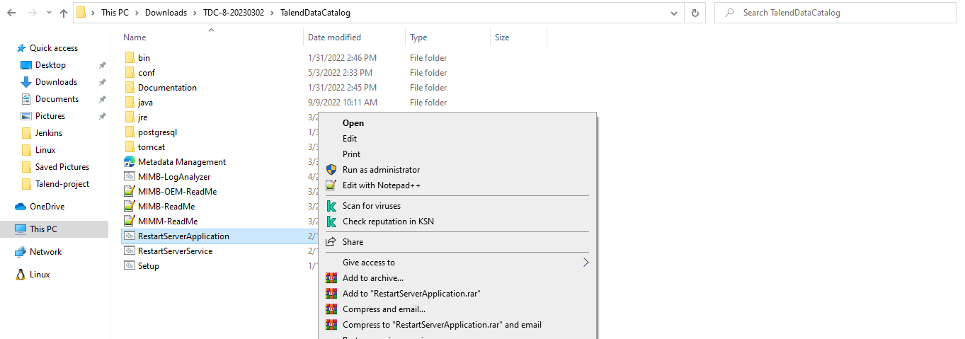
#Right click on RestartServerApplication
i)Run as administrator
#Restarts the application

Slide 9
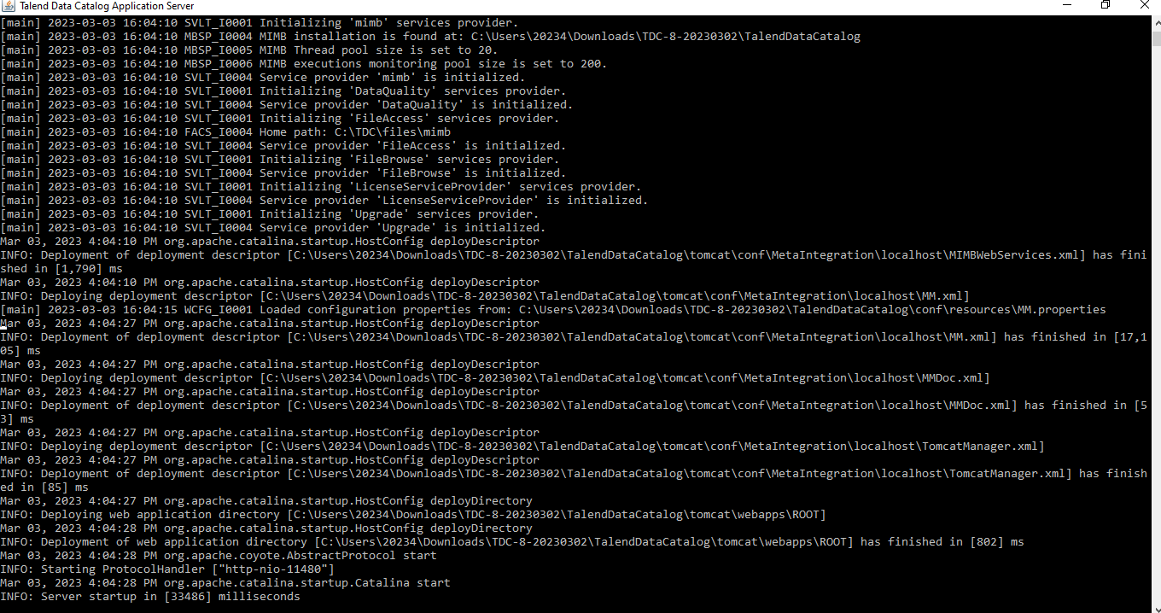
#Initialize and start the TDC server

Slide 10
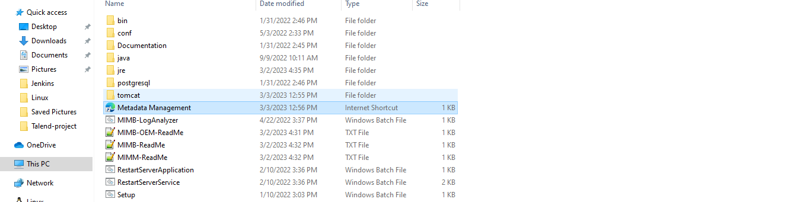
#Access the TDC from web browses
http://localhost:11480/MM
(or)
#Direct click on metadata management

Slide 11
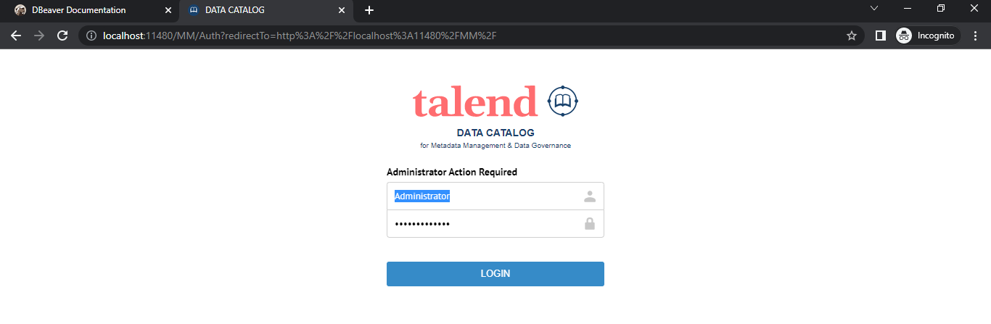
#http://localhost:11480/MM
User:- Administrator
Password:- Administrator

Slide 12
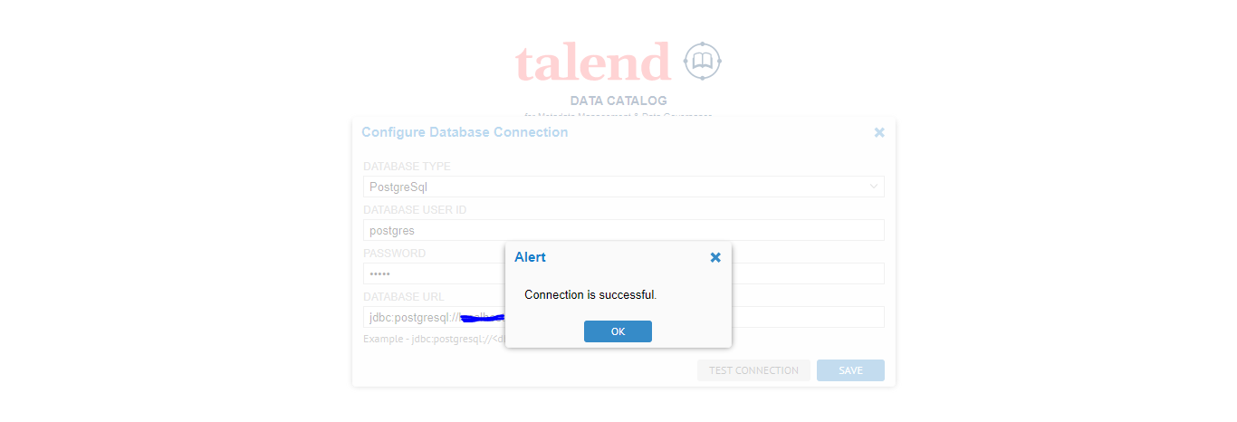
#sign in into the TDC
#configure the database setting
#check the database type
#check the connection and save it

Slide 13
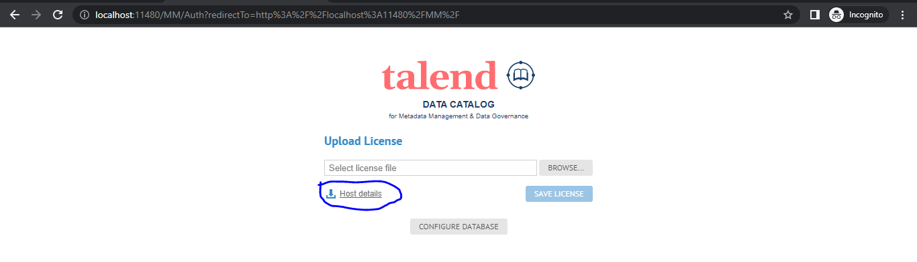
#Reload or again open the page
#Download the host.xml file
#Upload the Host.xml file in the URL provided with mail
It will generate the license then download the license
#Browse and upload the downloaded license and save it.

Slide 14
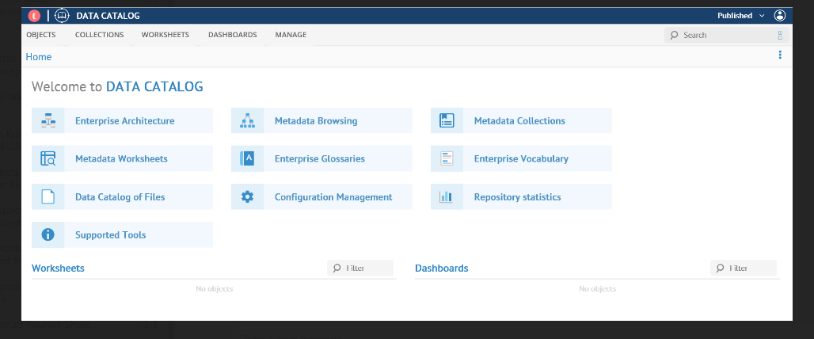
#Browse and upload the license file

